Slide 1


Columbia Asia hospital analysis
By Sai Sweatha S

Slide 2

Short info
Number of department- 7
Number of doctors- 22
Total Number of visits-9216
Number of years considered -2
Total revenue-$509m
Average Satisfaction score- 4.99

Slide 3
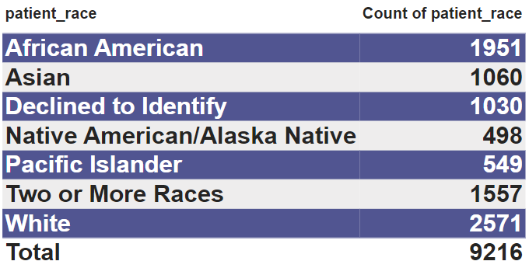
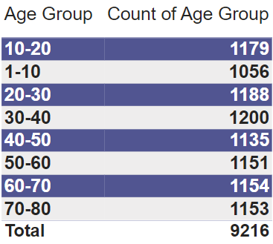
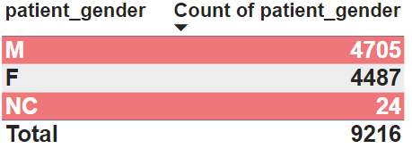
Patient DEMOGRAPHY
RACIAL BACKGROUND
AGE GROUP
GENDER

Slide 4






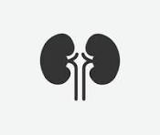
Department-wise Number of visits
General practice
orthopedics
physiotherapy
cardiology
gastroenterology
neurology
renal
7240
995
276
248
193
178
86
General practice department has the highest number of visits (7240) followed by orthopedics (995) and others.

Slide 5
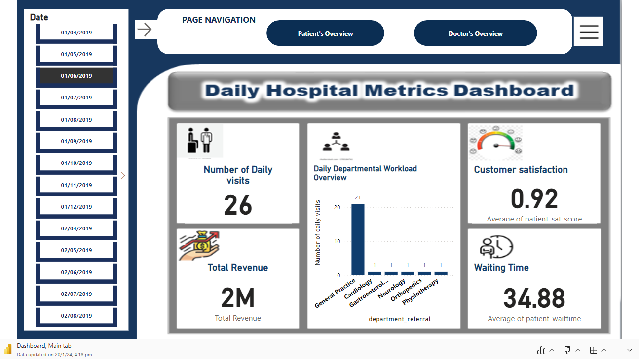

Slide 6
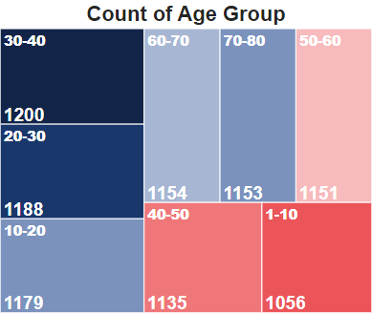
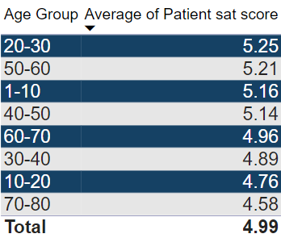

AGE GROUP ANALYSIS
There is no significant difference in the number of visits among the age groups; however 30-40 has utilized the healthcare service the most.
In the 20-30 age groups, people had the best experience with a satisfaction score of 5.25.
In the 70-80 age groups, the satisfaction score is 4.58, which is not as bad, but it indicates that this age group experienced a less positive experience compared to all other age groups.

Slide 7

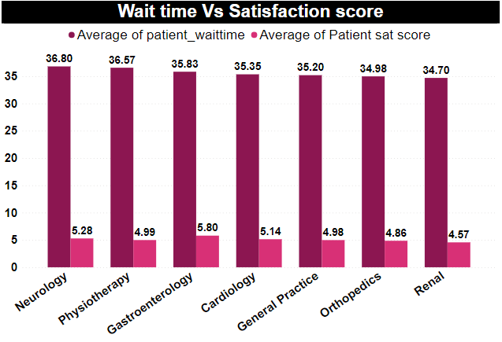
WAITING TIME vs SATISFACTION SCORE
There is no relation between how long a patient wait and their satisfaction scores.
Satisfaction scores generally fall between 4 and 6, while wait times typically range from 34 to 36.
It seems that extended wait times are not linked to lower satisfaction levels across different departments.

Slide 8
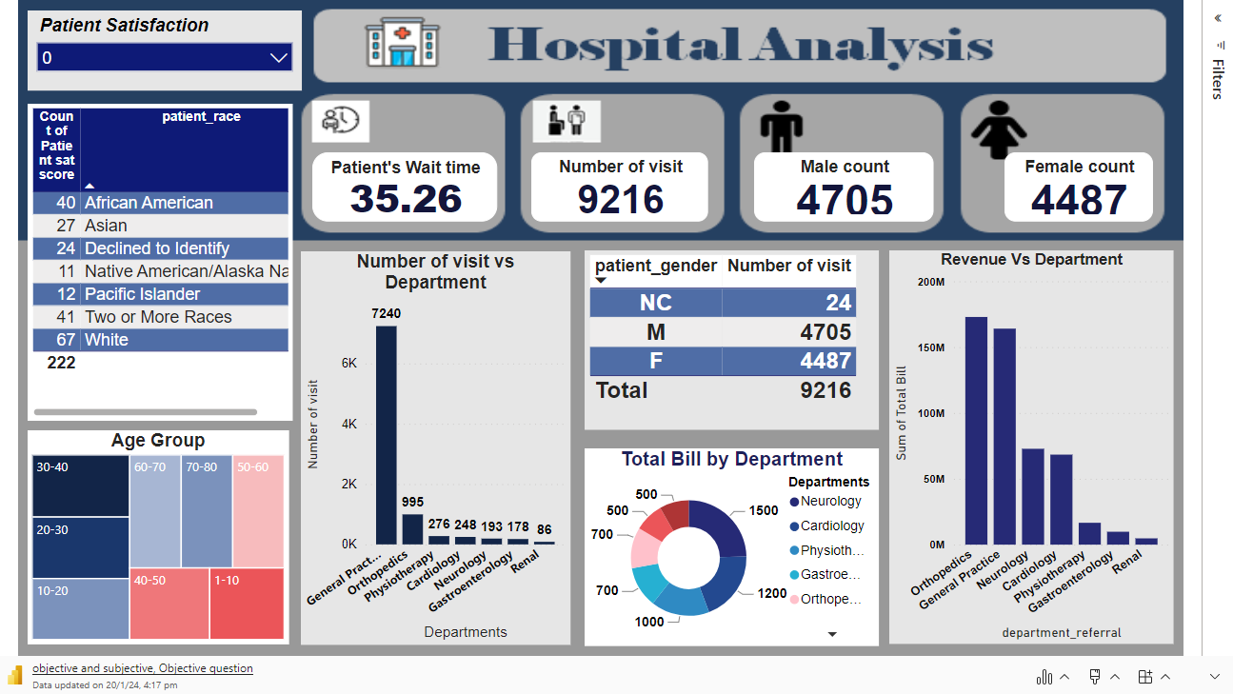

Slide 9
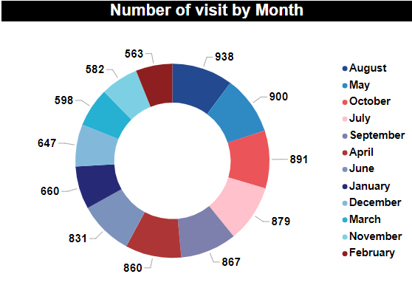

MONTHLY VISIT
June, July, August- 2648 visits
December, January, February- 1870 visits
March, April, May- 2358 visits
September, October, and November- 2340 visits
Overall, it appears that people tend to visit the hospital more frequently during the middle of the year.

Slide 10
Demographic insights
White people visit each department the most.
General practice department leads with the number of visits in each age group.
The age group 30-40 visits the hospital most
For gender, there is no major difference.

Slide 11
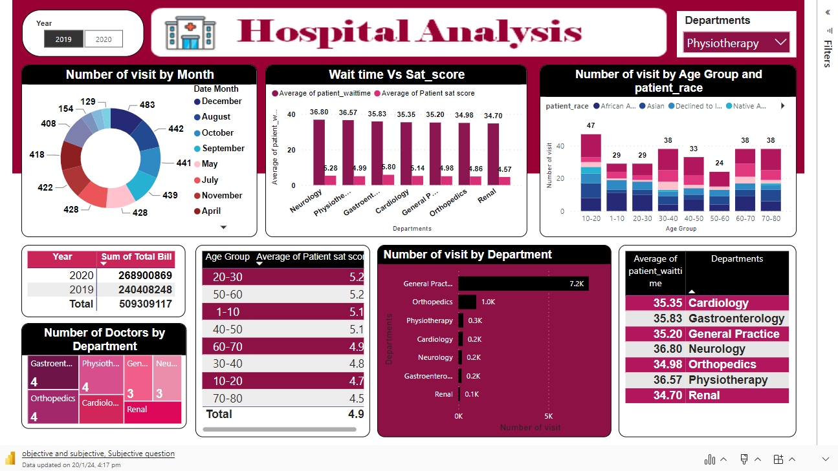

Slide 12
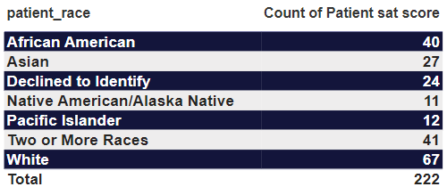
AREA FOR IMPROVEMENT
The department with the least number of zero satisfaction scores indicates there is a need for improvement.
From the table, it is understood that patients of white racial background have poor satisfaction scores.
CONT….

Slide 13

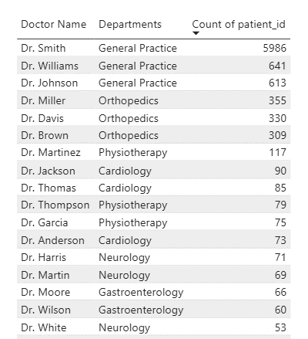
Doctor-patient ratio
In the General Practice department, a total of 7240 patient visit, but currently, there are only 3 doctors.
Therefore, hiring an additional 2-3 doctors for the General Practice department would be beneficial.

Slide 14
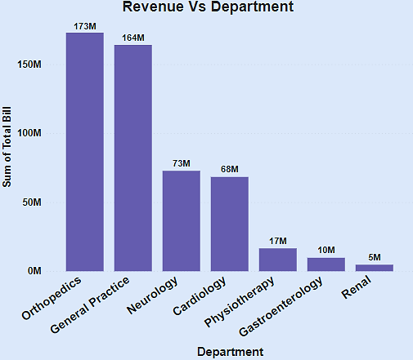

REVENUE OF DEPARTMENTS
It's clear that Orthopedics and General practice have the highest revenue, while Renal has the lowest revenue.

Slide 15
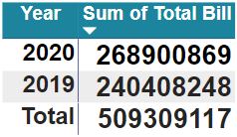

YEARLY REVENUE
The total revenue for the year 2019 was $240,408,248, and for the year 2020, $268,900,869 showing an increase of $28,492,621.
This indicates that the hospital is making a profit.

Slide 16

Thank you

